Slide 1
Grounding LLMs for increased accuracy
How to use Generative AI to create Content

Slide 2
Grounding caters responses to specific information
Grounding is the process of providing LLMs with a specific use case or data that is not available during the general part of the LLM’s pretrained data
Grounded LLMs are given a text base or examples and generate text based on those LLMs. This increases the accuracy of the responses and decreases the hallucinations

Slide 3
Why Grounding?
Typically we think of LLMs as a general wealth of knowledge. They can do general reasoning and are good text engines. However they are not completely accurate
They are also trained up to a certain time (September 2021 for GPT 3.5)
By grounding we can use them more as text engines to extract relevant information. We can also give them sensitive data like corporate files, etc
The normal process of grounding is called Retrieval Augmented Generation (RAG). RAG gets information relevant for a text and provides to the LLM as a prompt
Fine tuning is another way to increase accuracy which creates a new models with task specific info, however this only allows a 1-2% increase in accuracy
Source: https://techcommunity.microsoft.com/t5/fasttrack-for-azure/grounding-llms/ba-p/3843857#:~:text=Grounding%20is%20the%20process%20of,relevance%20of%20the%20generated%20output.

Slide 4
Common Use Cases
Grounding can be used with web search and question and answer interfaces
Google Generative Search Experience
Microsoft Bing Chat
Claude AI (Chat with PDF)
Microsoft Copilot
Google Duet AI

Slide 5
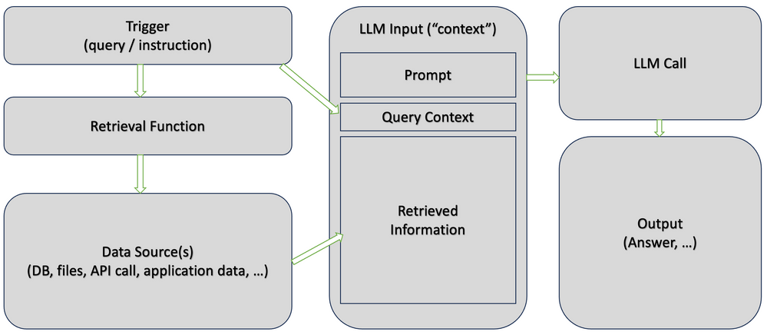
Simple RAG Model
The core LLM context is built with a prompt, query context and retrieved information.
When a user queries, it gets sent to a retrieval function that gets info from the data source. Then it builds all this info into an LLM context which is sent to the LLM
This is similar to a wrapper on a foundational model like Llama, Palm, or GPT

Slide 6
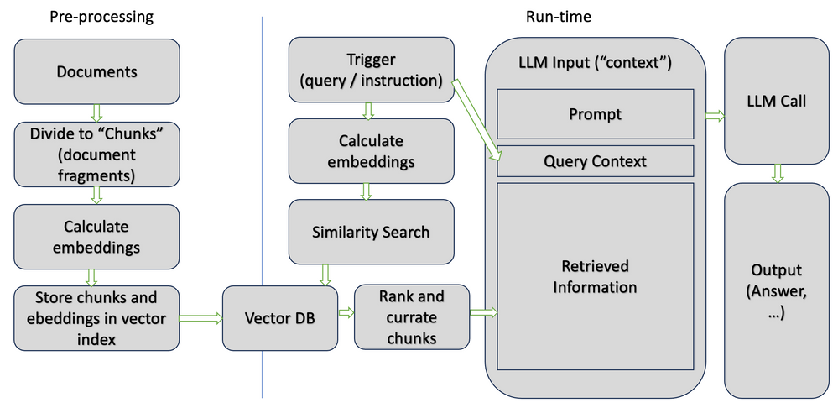
Simple Preprocessing Model
By preprocessing the documents into chunks and storing into a vector DB, we can make the RAG model run more efficiently.
This is a way of speeding up the RAG model execution time, once the items are preprocessed the remaining work is similar to the previous slide.

Slide 7
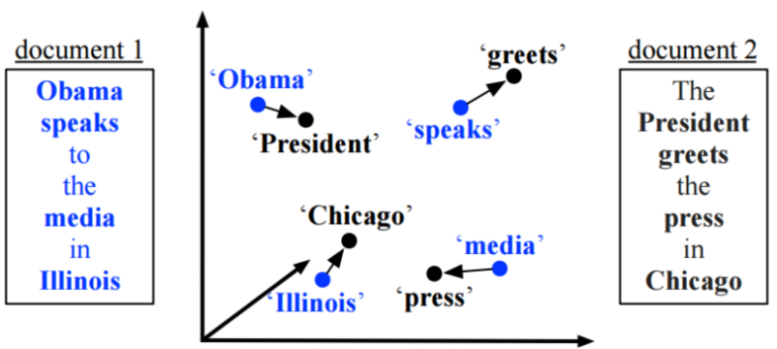
Embeddings find similarities between text
Semantic search is a common way of finding relevant text
For example the sentence Obama speaks to the media in Illinois is similar to The President greets the press in Chicago.
This is because Obama is the same as President, speaks is the same as greets, media is the same as press, and Illinois is the same as Chicago.
A technique like this makes it easier to find meaning in a large pile of text and in turn a popular preprocessing step in RAG models

Slide 8
Limitations
Typically LLMs are a fixed context window size and models such as GPT 3, GPT 4, PaLM, and Llama might have too small of a context window to effectively perform RAG. One way around this is to rank information and only keep the most relevant info
Ordering is important, sometimes incorrect sequences will cause wrong information. A general rule of thumb, is if it doesnt make sense to a human, it wont make sense to an LLM
Formatting the LLM context can also change the output. We usually want to put spaces between each piece of relevant information

Slide 9
Tradeoffs
The largest tradeoffs come in the form of speed vs cost vs accuracy
For those building the tools there is a tradeoff of preprocessing vs runtime
By introducing an extra step (LLM context building) to build the LLM query, this will cause a slowdown as well as use more compute resources
In addition the extra processing will make tools more expensive, as a benefit you get greater accuracy from your queries.
For developers there is a question whether we should preprocess the data or perform it at runtime, which is more expensive and slow.

